Slide 1
Team Water Meldon
DataRes Demo Day
By: Samantha, Annie, Shreesh, Isha

Slide 2
Dataset Introduction
Obtained a dataset from Kaggle on COVID 19 vaccinations
This dataset includes data such as number of people vaccinated (in millions) for different countries, what company vaccines are utilized most in each country, etc.
We are interested in analyzing trends and connecting to real world ‘events’ (politics and policies, Gross Domestic Product etc.)
Performed Time series analysis on some continents

Slide 3
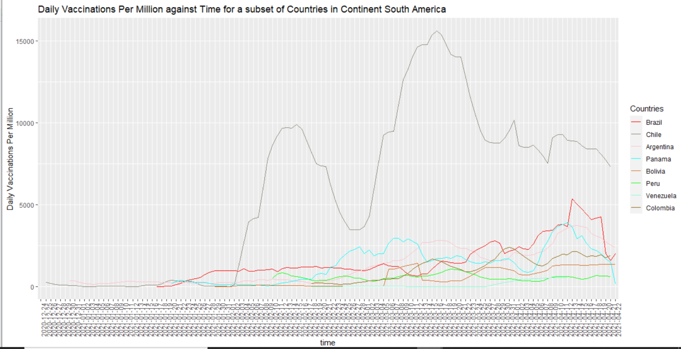
Continent of South America

Slide 4
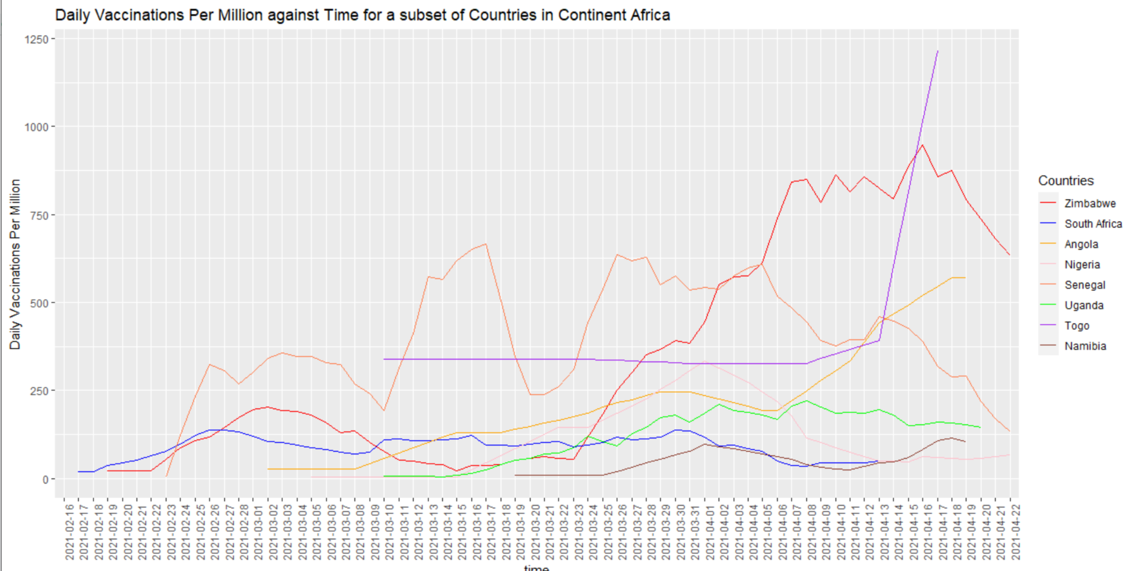
Continent of Africa

Slide 5
Some interesting points about the two plots
In continent of Africa, it seems that Togo and Zimbabwe have been experiencing an increase in the number of vaccinations per million over time
However, these countries have a lower Gross Domestic Product as compared to countries such as South Africa
A BBC article shows that the World Health Organization has been aiming to increase vaccination distributions in countries such as Togo
In South America:
Chile has an increasing trend vaccinations
Other countries including: Argentia, Panama, Venezuela, and Colombia seems to display a relatively “stable” trend in their vaccinations with increasing and decreasing numbers from a day to day basis
Chile has one of the highest GDP values in South America

Slide 6
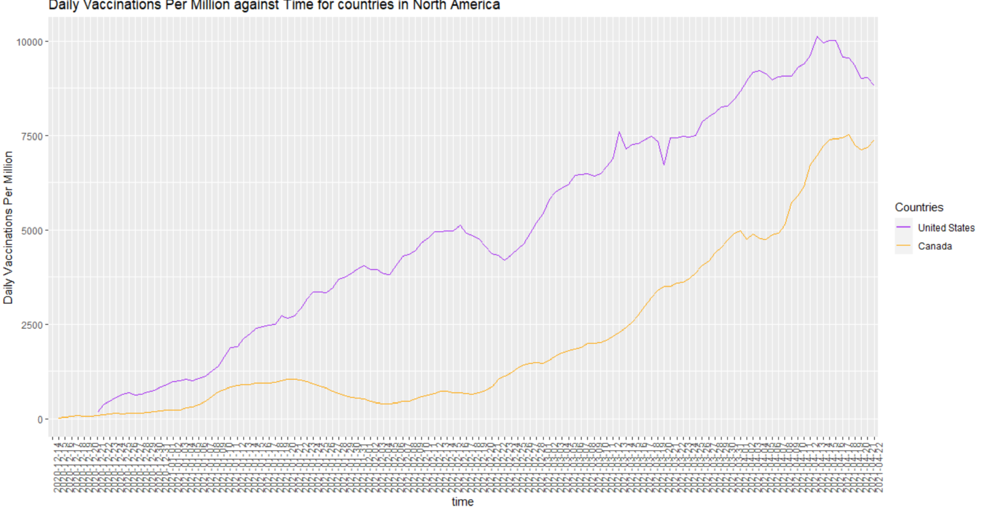
Continents of North America

Slide 7
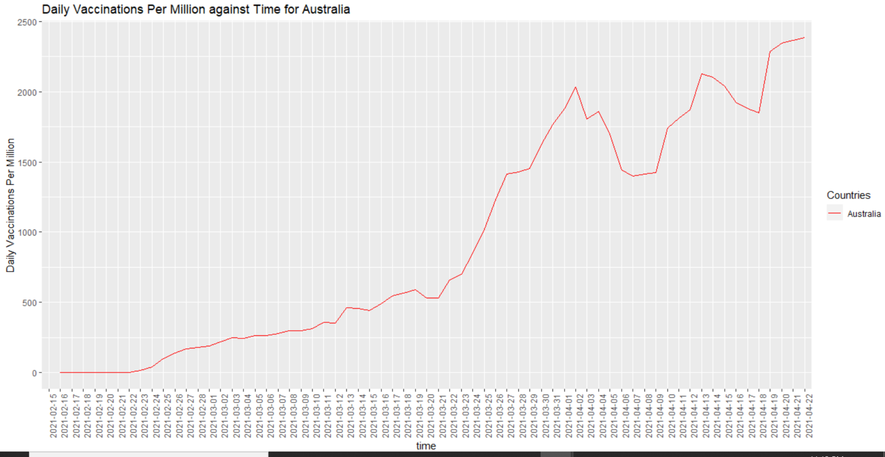
Continent of Australia

Slide 8
Some analysis
The United States and Canada displays a very similar trend in vaccinations per million
Australia displays an increasing trend as well
These are trends expected, as all of these continents/countries are associated with relative high levels of GDP

Slide 9
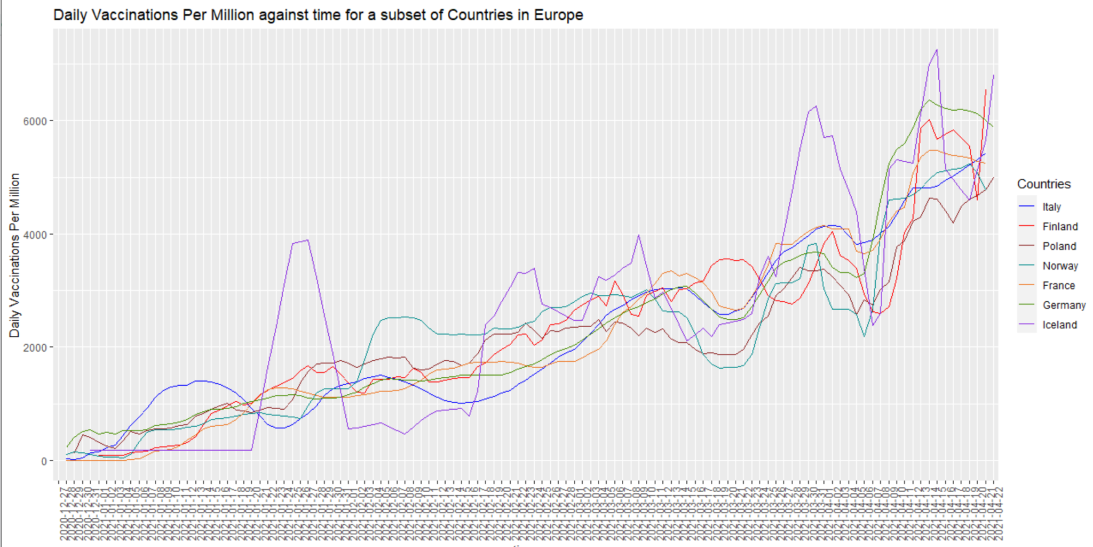
Continent of Europe

Slide 10
Some Points of analysis
Many of these European countries follow a very similar “trend” and the number of vaccinations per million are not different than each other.
Most likely because of the European Union - and because they are part of this Union, we can hypothesize their vaccination strategies to be in tune with each other

Slide 11
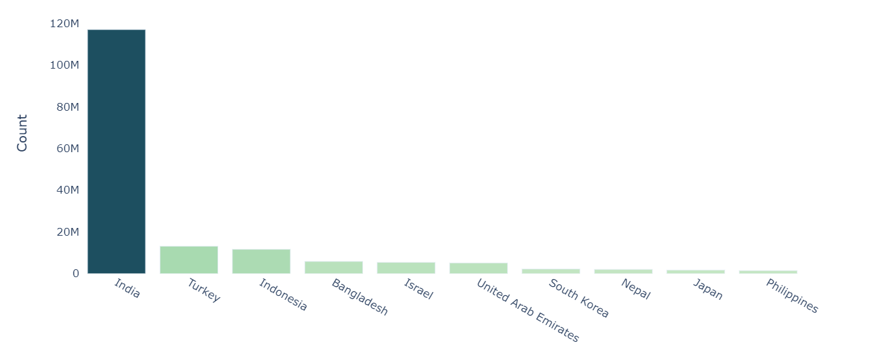
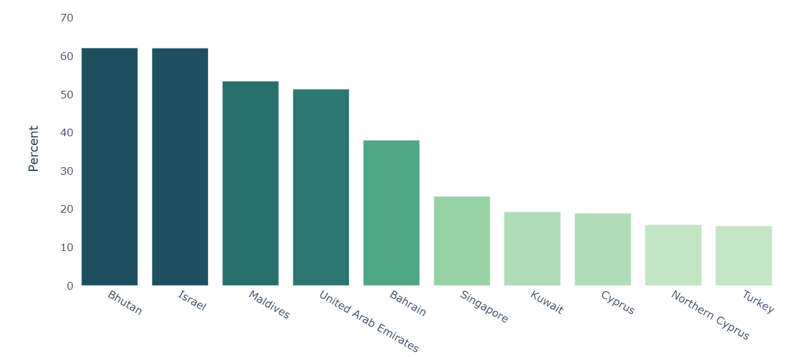
Continent of Asia

Slide 12
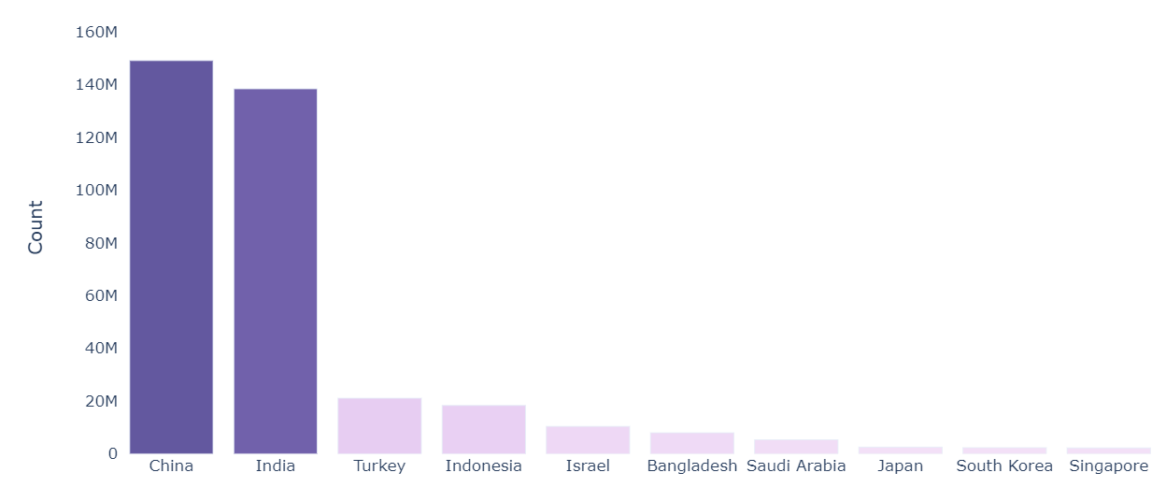
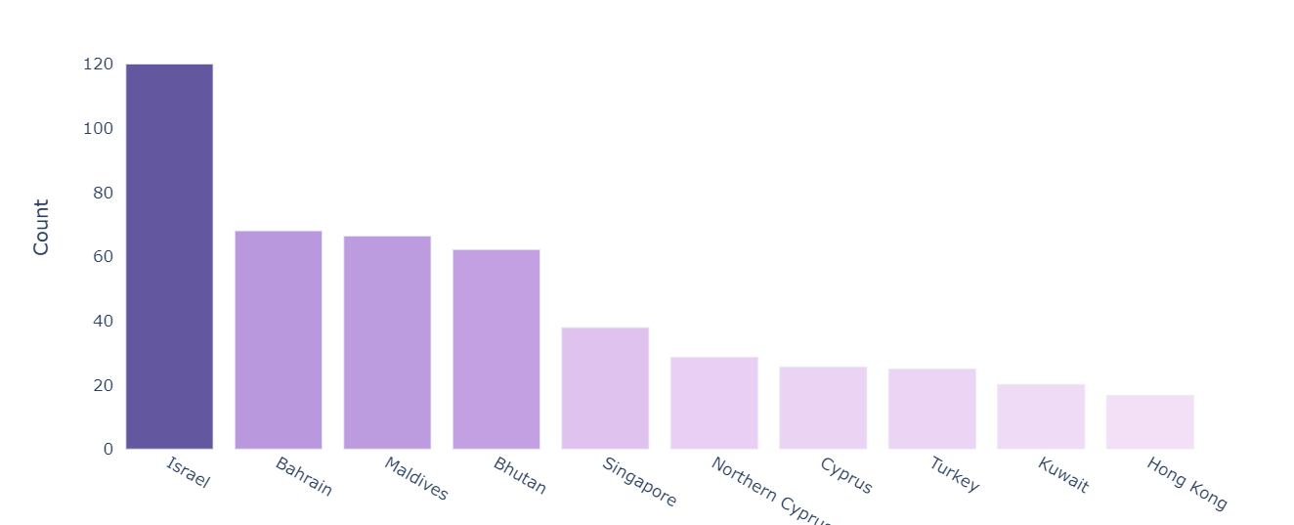
Continent of Asia

Slide 13

Continent of Asia

Slide 14
General Conclusions
There are complicated political factors beyond economical factors that correlates with vaccine distribution.
This is different from our original “hypothesis” with the idea that the GDP contributes to number of vaccines distributed.

